Slide 1
Airline Passenger Satisfaction
or: How can we make our customers happier?

Slide 2
Agenda
The problem
The data
Current customer experience
Focus areas to improve satisfaction

Slide 3
Invistico Airlines
Questions
- How satisfied are our customers currently with our services?
- Where should we invest to improve customer satisfaction on board our flights?

Slide 4
Our Data
We’ll use real airline data, anonymised, to answer our questions.
Nearly 130,000 customers were asked, overall, if they were satisfied or dissatisfied with their flight.
The data also contains a collection of customer ratings (1-5) for various flight services such as legroom, food and drink and online bookings.
We have customer profile data too, such as age, class and reason for flight, and flight distance.

Slide 5
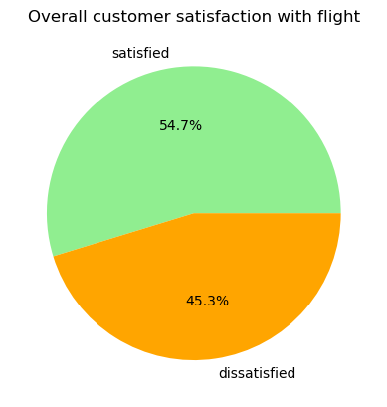
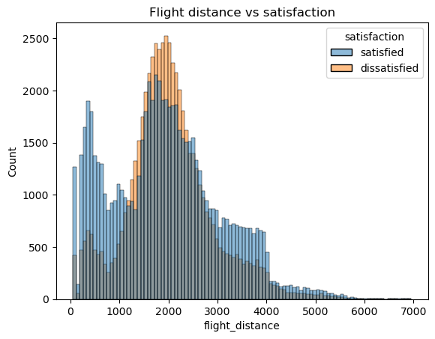
Current customer satisfaction
- Older customers are generally more satisfied than younger ones
Short flight delays do not appear to impact satisfaction, however longer delays do.
Shorter (<1000 miles) or long haul (>3000 miles) flights have better satisfaction levels than medium haul flights
Notes:
Older custs: possibly, younger customers are more discerning. We also noticed that our business travelling customers tend to be younger (not business class always, but not leisure travelers), and that our non-repeat/disloyal customers tend to be younger. So it is possible that it is these groups who are reporting lower satisfaction. E.g. if you are flying for business, you might expect certain services to be available, or you need to be at a destination by a certain time. Disloyal customers might be still deciding if you are a right fit as a business.
- Customer loyalty overall did not show a large difference in the proportion of satisfied vs dissatisfied customers, however as just mentioned, other factors like age look to be closely tied to loyalty, and have other strong ties to satisfaction.
The average flight delays was 14 minutes. Over three quarters of flights re delayed less than 12 minutes, so the average is being dragged out by some rare longer delay experiences. Certainly, when delays are longer (over 60 minutes) then there is an impact on customer satisfaction.
One explanation for the drop in satisfaction on our medium-haul flights is customer expectations. In shorter journeys, customers might be easier to satisfy as they know their flight is not going to take long and services are on most airlines limited in these cases. However, customers may be expecting medium haul flights to have similar services to long haul, e.g. multiple meal services, a certain level of inflight entertainment, or better legroom. We don’t have the data to expand on this now, but it would be worth gathering some data on customer expectations on services vs flight length.

Slide 6
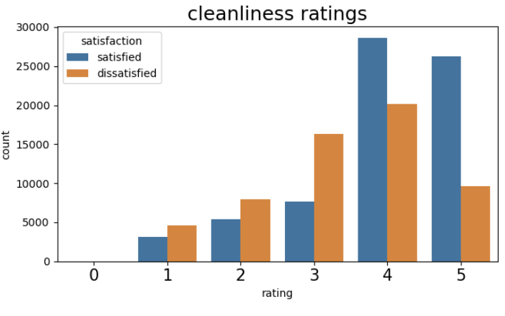
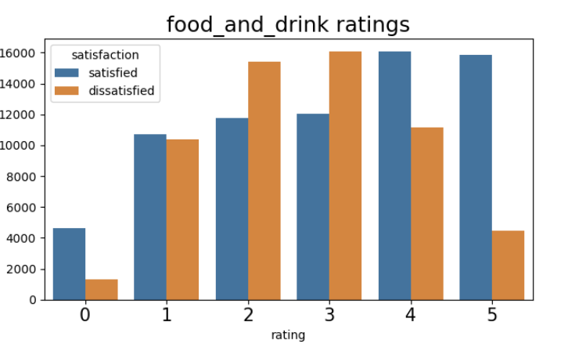
Current customer satisfaction
Best rated services: cleanliness, baggage handling, online support and legroom
Worst rated services: seat comfort, food and drink, gate location
Notes:
These are calculated purely on the number of 4 or 5 star ratings summed, or 0-2 star ratings summed.
We can see that cleanliness was rated quite well even by dissatisfied customers, and so is our best performing service.
On the other hand, food and drink looks to be very divisive. Where customers are satisfied with us, it is not true that they are also happy with their meals. The opposite can be said of dissatisfied customers: some are quite happy with their meals while being dissatisfied overall. By and large though, customers feel pretty middling about our food and drink service. A similar picture can be seen for seat comfort.

Slide 7
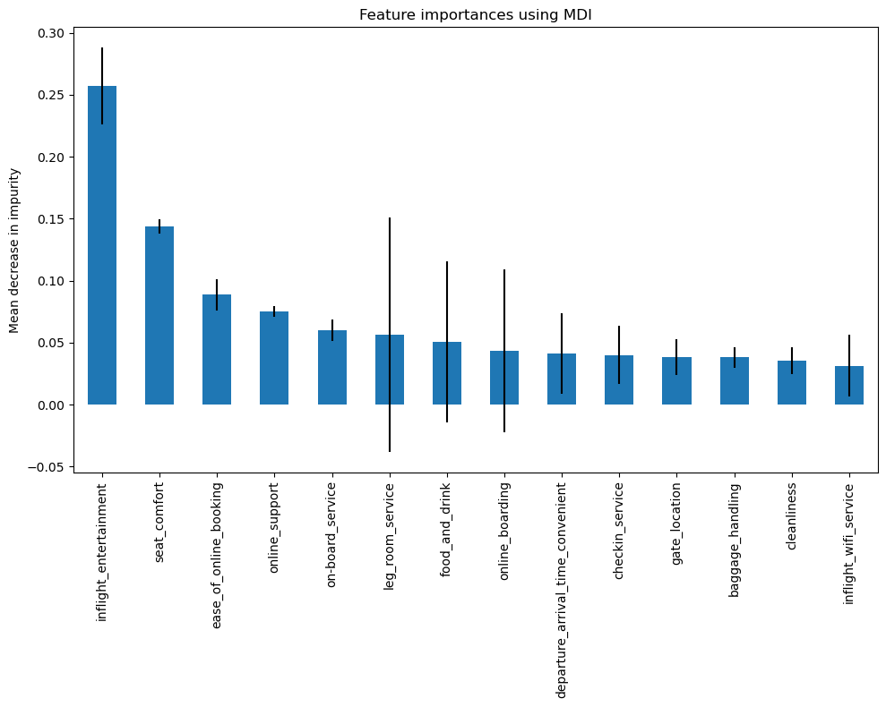
Predicting satisfaction
Using machine learning, we can predict customer satisfaction based on service ratings with an accuracy of ~95%.
The model suggests most important features as inflight entertainment and seat comfort. Flight Class differences do have an impact.
Notes:
For business class, leg room has more impact on satisfaction currently, while in economy it is food and drink. The errors for those bars are reduced significantly when plotting just the business class or economy/economy plus customers separately.
Gate location, whilst divisive and rated amongst the worst services when summing customer ratings, appears to have little impact on whether a customer is overall satisfied or dissatisfied with their experience.

Slide 8
Recommendations
Investment in the following services is recommended to improve customer satisfaction:
- Economy and economy plus customer meals
Business class legroom
Seat comfort across all flight classes
Further research into medium—haul flight service expectations
- In flight entertainment is a hugely important factor – ensure this service is kept as up to date as possible with customer expectations.
Notes:
For business class, leg room has more impact on satisfaction currently, while in economy it is food and drink. The errors for those bars are reduced significantly when plotting just the business class or economy/economy plus customers separately.

